Slide 1


Product Catalog 2013/2014

Slide 2

People,
Product,
Culture,
Opportunity

Slide 3

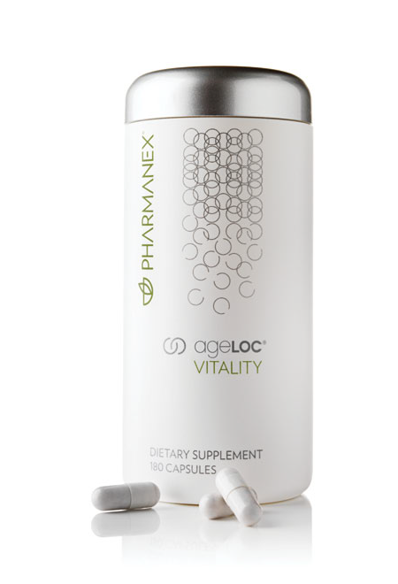
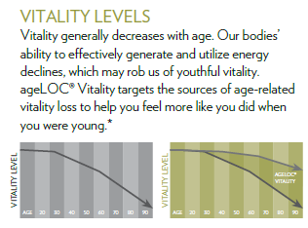
AGELOC VITALITY Dietary Supplement Capsules
Vitality levels
Vitality generally deceases with age. Our bodies’ ability to effectively generate and utilize energy declines, which may rob us of youthful vitality. ageLOC Vitality targets the sources of age-related vitality loss to help you feel more like you did when you were young.

Slide 4
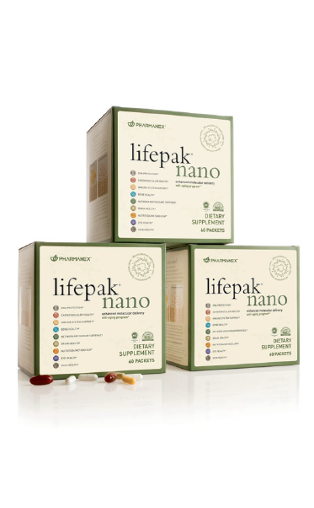
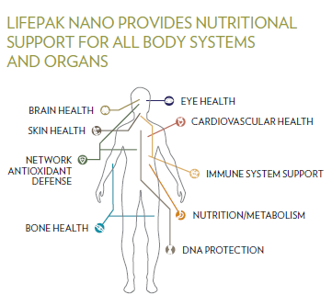
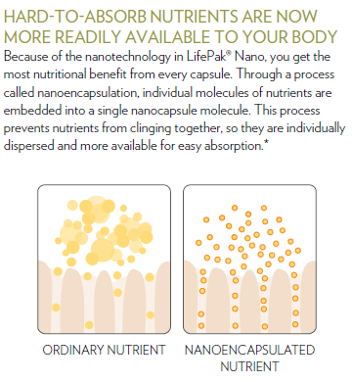
LIFEPAK NANO PROVIDES NUTRITIONAL SUPPORT FOR ALL BODY SYSTEMS AND ORGANS
HARD-TO-ABSORB NUTRIENTS ARE NOW MORE READILY AVAILABLE TO YOUR BODY
Because of the nanotechnology in LifePak® Nano, you get the
most nutritional benefit from every capsule. Through a process
called nanoencapsulation, individual molecules of nutrients are
embedded into a single nanocapsule molecule. This process
prevents nutrients from clinging together, so they are individually
dispersed and more available for easy absorption.*

Slide 5

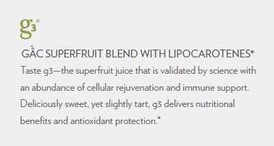
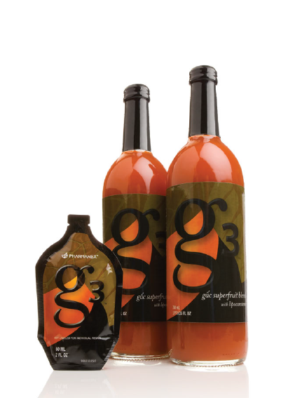
gac superfruit blend with lipocarotenesR
Taste g3—the superfruit juice that is validated by science with
an abundance of cellular rejuvenation and immune support.
Deliciously sweet, yet slightly tart, g3 delivers nutritional
benefits and antioxidant protection.*

Slide 6
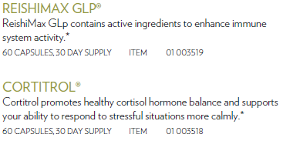
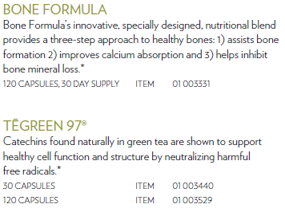
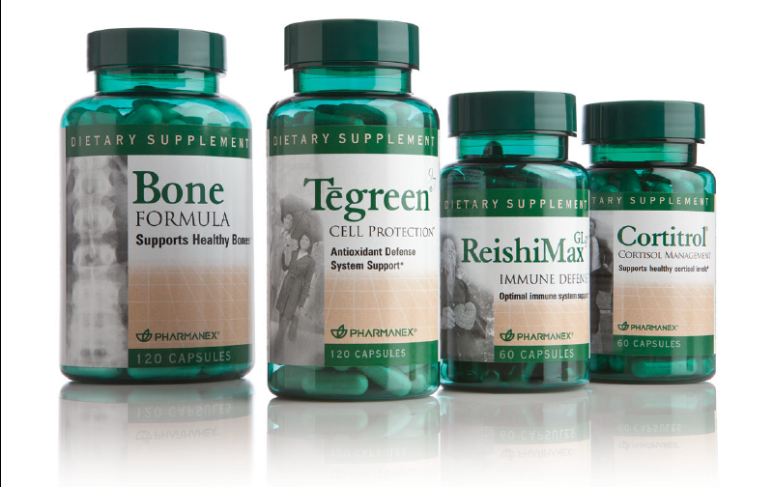
ReishiMax GLpR
ReishiMax GLp contains active ingredients to enhance immune
system activity.*
60 capsules, 30 day supply item 01 003519
CortitrolR
Cortitrol promotes healthy cortisol hormone balance and supports
your ability to respond to stressful situations more calmly.*
60 capsules, 30 day supply item 01 003518
* T hese statements have not been evaluated by the
Food and Drug Administration. These products are not
intended to diagnose, treat, cure, or prevent any disease.
Bone Formula
Bone Formula’s innovative, specially designed, nutritional blend
provides a three-step approach to healthy bones: 1) assists bone
formation 2) improves calcium absorption and 3) helps inhibit
bone mineral loss.*
120 capsules, 30 day supply item 01 003331
TĒgreen 97R
Catechins found naturally in green tea are shown to support
healthy cell function and structure by neutralizing harmful
free radicals.*
30 capsules Item 01 003440
120 capsules Item 01 003529

